Slide 1
PIZZA SALES REPORT – SQL AND TABLEAU
- MELVIN SUJAY

Slide 2
INTRODUCTION
Business Problem / Objective:
To provide a clear and interactive dashboard for tracking pizza sales, order patterns, and performance trends across different time periods and product categories.
To identify top-performing and underperforming pizza products, peak business hours, and customer preferences by category and size.
To support data-driven decision-making for menu optimization, staffing efficiency, and inventory management through visual analytics.
Business Challenges:
Lack of visibility into sales performance across different hours, days, and weeks
Difficulty in identifying top-performing pizzas and underperforming menu items
Need to understand customer preferences by pizza category, size, and specific products
Requirement to track hourly and weekly sales patterns for operational efficiency
Need to optimize menu offerings and staffing based on demand patterns

Slide 3
DATA PREPARATION
Data Import & Setup:
Imported CSV file (pizza_sales.csv) into Microsoft SQL Server Management Studio
Created database 'Pizza_DB' and imported flat file with 48,620 transaction records
Optimized data types: Changed NVARCHAR(50) to VARCHAR(50), pizza_ingredients to VARCHAR(MAX), and pizza_id/order_id from SMALLINT to INT
Data Validation:
Executed SELECT * FROM pizza_sales query to verify data integrity
Validated all columns: pizza_id, order_id, pizza_name_id, quantity, order_date, order_time, unit_price, total_price, pizza_size, pizza_category, pizza_ingredients, pizza_name
Data Export for Tableau:
Exported SQL data to Excel format for Tableau Public compatibility
Maintained data structure and relationships for seamless visualization
Data set data period: January 1, 2015 - December 31, 2015 (1 full year, 365 days)

Slide 4




KPI’s REQUIREMENT
SQL QUERIES:
We need to analyze key indicators for our pizza sales data to gain insights into our business performance. Specifically, we want to calculate the following metrics:
1. Total Revenue: The sum of the total price of all pizza orders.
SELECT SUM(total_price) AS Total_Revenue
FROM pizza_sales
2. Average Order Value: The average amount spent per order, calculated by dividing the total revenue by the total number of orders.
SELECT SUM(total_price) / COUNT(DISTINCT order_id) AS Avg_Order_Value
FROM pizza_sales
3. Total Pizzas Sold: The sum of the quantities of all pizzas sold.
SELECT SUM(quantity) AS Total_Pizza_Sold
FROM pizza_sales
4. Total Orders: The total number of orders placed.
SELECT COUNT(DISTINCT order_id) AS Total_orders
FROM pizza_sales

Slide 5

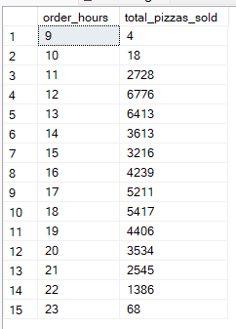
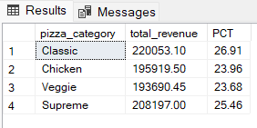
5. Average Pizzas Per Order: The average number of pizzas sold per order, calculated by dividing the total number of pizzas sold by the total number of orders.
SELECT CAST(CAST(SUM(quantity) AS DECIMAL(10,2)) /
CAST(COUNT(DISTINCT order_id) AS DECIMAL(10,2)) AS DECIMAL(10,2))
AS Avg_Pizzas_Per_order
FROM pizza_sales
Trend Analysis Queries:
1. Hourly Trend for Total Pizzas Sold:
SELECT DATEPART(HOUR, order_time) AS order_hour,
SUM(quantity) AS Total_pizzas_sold
FROM pizza_sales
GROUP BY DATEPART(HOUR, order_time)
ORDER BY DATEPART(HOUR, order_time)
2. Percentage of Sales by Pizza Category:
SELECT pizza_category,
CAST(SUM(total_price) AS DECIMAL(10,2)) AS Total_Sales,
CAST(SUM(total_price) * 100 /
(SELECT SUM(total_price) FROM pizza_sales)
AS DECIMAL(10,2)) AS PCT
FROM pizza_sales
GROUP BY pizza_category

Slide 6
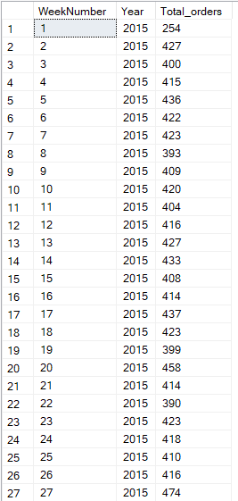
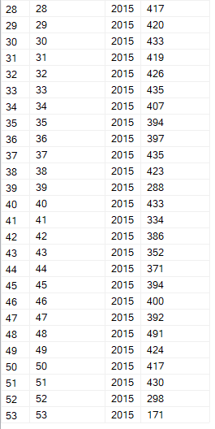
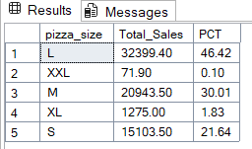
3. Weekly Trend for Total Orders:
SELECT DATEPART(ISO_WEEK, order_date) AS week_number,
YEAR(order_date) AS order_year,
COUNT(DISTINCT order_id) AS Total_orders
FROM pizza_sales
GROUP BY DATEPART(ISO_WEEK, order_date), YEAR(order_date)
ORDER BY DATEPART(ISO_WEEK, order_date), YEAR(order_date)
4. Percentage of Sales by Pizza Size:
SELECT pizza_size, CAST(SUM(total_price) AS DECIMAL(10,2)) as total_revenue,
CAST(SUM(total_price) * 100 / (SELECT SUM(total_price) from pizza_sales) AS DECIMAL(10,2)) AS PCT
FROM pizza_sales
GROUP BY pizza_size
ORDER BY pizza_size

Slide 7
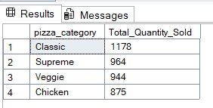
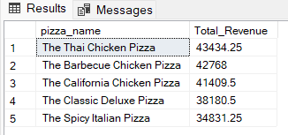
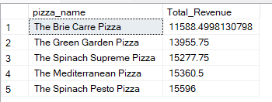
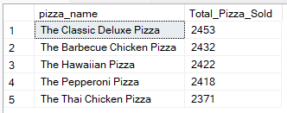
5. Total Pizzas Sold by Pizza Category
SELECT pizza_category, SUM(quantity) as Total_Quantity_Sold
FROM pizza_sales
WHERE MONTH(order_date) = 2
GROUP BY pizza_category
ORDER BY Total_Quantity_Sold DESC
6. Top 5 Pizzas by Revenue
select top 5 pizza_name, sum(total_price) as Total_Revenue from pizza_sales
group by pizza_name
order by Total_Revenue desc
7. Bottom 5 Pizzas by Revenue
select top 5 pizza_name, sum(total_price) as Total_Revenue from pizza_sales
group by pizza_name
order by Total_Revenue asc
8. Top 5 Pizzas by Quantity
SELECT Top 5 pizza_name, SUM(quantity) AS Total_Pizza_Sold
FROM pizza_sales
GROUP BY pizza_name
ORDER BY Total_Pizza_Sold DESC

Slide 8
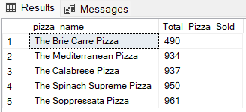
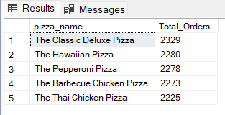
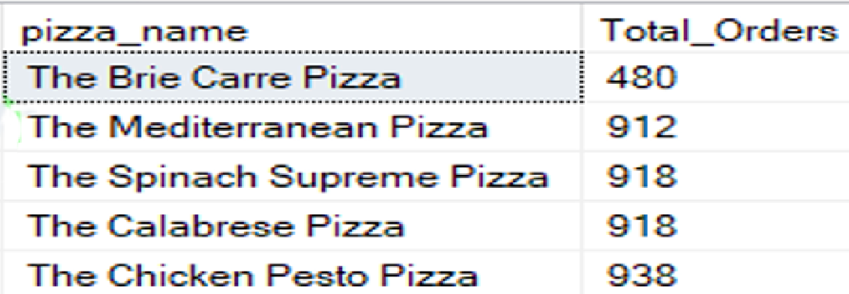


9. Bottom 5 Pizzas by Quantity
SELECT TOP 5 pizza_name, SUM(quantity) AS Total_Pizza_Sold
FROM pizza_sales
GROUP BY pizza_name
ORDER BY Total_Pizza_Sold ASC
10. Top 5 Pizzas by Total Orders
SELECT Top 5 pizza_name, COUNT(DISTINCT order_id) AS Total_Orders
FROM pizza_sales
GROUP BY pizza_name
ORDER BY Total_Orders DESC
11. Bottom 5 Pizzas by Total Orders
SELECT Top 5 pizza_name, COUNT(DISTINCT order_id) AS Total_Orders
FROM pizza_sales
GROUP BY pizza_name
ORDER BY Total_Orders ASC

Slide 9
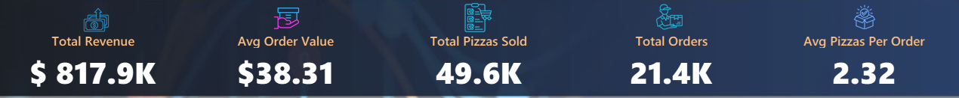
TABLEAU IMPLEMENTATION
Calculated Fields Created in Tableau:
Replicating SQL KPI Logic:
Total Revenue = SUM([Total Price])
Total Orders = COUNTD([Order Id])
Avg Order Value = [Total Revenue] / [Total Orders]
Total Pizzas Sold = SUM([Quantity])
Avg Pizzas Per Order = [Total Pizzas Sold] / [Total Orders]
Additional Measures:
Max Date = MAX([Order Date])
Min Date = MIN([Order Date])
Neg Total Pizzas Sold = -[Total Pizzas Sold] (for bi-directional chart)
Data Validation: SQL Results = Tableau Results (KPI consistency verified)
Time Dimension Handling:
Extracted Hour from Order Time for hourly analysis
Used ISO Week Numbers for weekly trend analysis
Custom date range display (01-01-2015 to 31-12-2015)

Slide 10
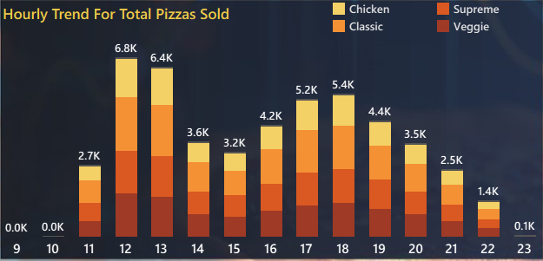
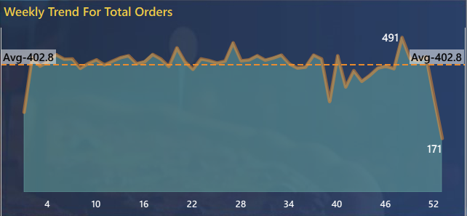
KPI’s CHARTS REQUIREMENT
1. Hourly Trend for Total Pizzas Sold:
Chart Type: Stacked Bar Chart (Dual Axis with Gantt Chart Overlay)
Purpose: Display pizza sales volume across different hours of the day
Fields: X-axis: Order Time (Hour), Y-axis: Total Pizzas Sold, Color: Pizza Category
Insight: Peak orders are between 12:00 PM and 1:00 PM, and in evening, from 4:00 PM to 7:00 PM. Enables optimal staff scheduling and inventory preparation.
2. Weekly Trend for Total Orders:
Chart Type: Area Chart with Average Reference Line
Purpose: Track the trend of total orders week-over-week throughout the year
Fields: X-axis: Week Number (ISO Week), Y-axis: Total Orders, Reference: Average (402.8)
Insight: Significant variations in weekly orders, with highest peak during the 48th week from December. Holiday season surge requires extra inventory planning.

Slide 11
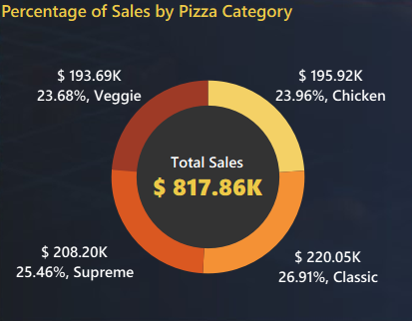
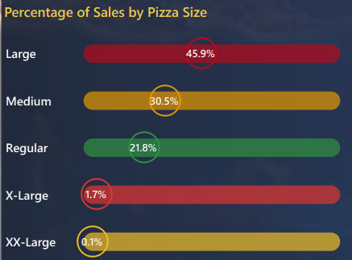
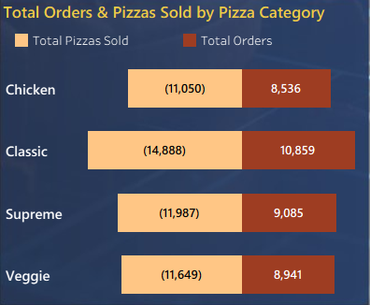
3. Percentage of Sales by Pizza Category:
Chart Type: Donut Chart
Purpose: Show revenue distribution across the four main pizza categories
Fields: Slices: Pizza Category, Values: Total Sales & Percentage, Center: Total Sales
Results: Classic (26.91%), Supreme (25.46%), Chicken (23.96%), Veggie (23.68%)
Insight: Classic Category contributes to maximum Sales. All categories fairly balanced (23-27%), indicating diverse customer preferences.
4. Percentage of Sales by Pizza Size:
Chart Type: Horizontal Bar Chart with Percentage Labels
Purpose: Display sales distribution across different pizza sizes
Fields: Y-axis: Pizza Size, X-axis: Percentage of Total Sales
Results: Large (45.9%), Medium (30.5%), Regular (21.8%), X-Large (1.7%), XX-Large (0.1%)
Insight: Large Pizza Size contributes to maximum Total Sales. XL and XXL sizes have minimal contribution.
5. Total Orders & Pizzas Sold by Pizza Category:
Chart Type: Horizontal Bar Chart (Bi-Directional)
Purpose: Compare total quantity sold and total orders for each category side-by-side
Fields: Y-axis: Pizza Category, Left: Total Pizzas Sold, Right: Total Orders
Insight: Classic category leads in both quantity (14,888) and orders (10,859). Useful for inventory planning.

Slide 12
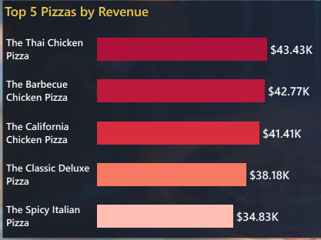
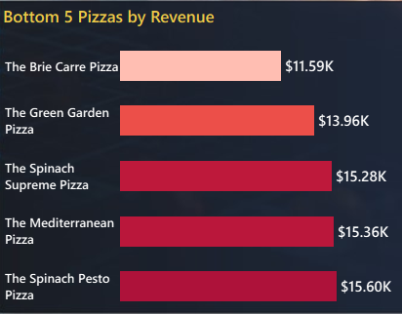
6. Top 5 Pizzas by Revenue:
Chart Type: Horizontal Bar Chart
Purpose: Highlight best-selling pizzas based on total revenue
Top 5: Thai Chicken ($43.43K), Barbecue Chicken ($42.77K), California Chicken ($41.41K), Classic Deluxe ($38.18K), Spicy Italian ($34.83K)
Insight: The Thai Chicken Pizza contributes to Maximum Revenue. Chicken-based pizzas dominate top revenue.
7. Bottom 5 Pizzas by Revenue:
Chart Type: Horizontal Bar Chart
Bottom 5: Brie Carre ($11.59K), Green Garden ($13.96K), Spinach Supreme ($15.28K), Mediterranean ($15.36K), Spinach Pesto ($15.60K)
Insight: The Brie Carre Pizza contributes to Minimum Revenue. Vegetable-heavy pizzas underperform.

Slide 13
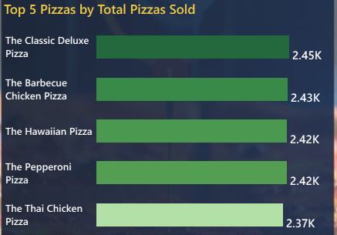
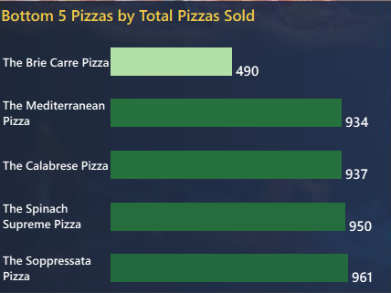
8. Top 5 Pizzas by Total Pizzas Sold:
Chart Type: Horizontal Bar Chart
Purpose: Show highest volume sellers based on quantity
Top 5: Classic Deluxe (2,453), Barbecue Chicken (2,432), Hawaiian (2,422), Pepperoni (2,418), Thai Chicken (2,371)
Insight: The Classic Deluxe Pizza Contributes to Maximum Total Quantities. High-volume items require consistent ingredient availability and efficient preparation processes.
9. Bottom 5 Pizzas by Total Pizzas Sold:
Chart Type: Horizontal Bar Chart
Purpose: Identify lowest volume sellers for menu optimization
Bottom 5: Brie Carre (490), Mediterranean (934), Calabrese (937), Spinach Supreme (950), Soppressata (961)
Insight: The Brie Carre Pizza contributes to Minimum Total Quantities. Consistent with revenue findings - specialty and vegetable pizzas have lower demand.

Slide 14
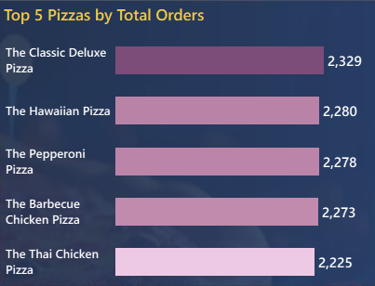
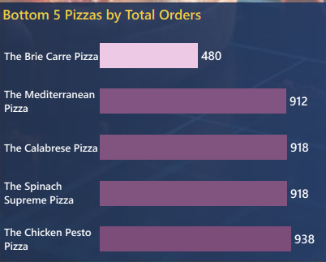
10. Top 5 Pizzas by Total Orders:
Chart Type: Horizontal Bar Chart
Purpose: Show which pizzas appear in the most distinct orders (customer preference frequency)
Top 5: Classic Deluxe (2,329), Hawaiian (2,280), Pepperoni (2,278), Barbecue Chicken (2,273), Thai Chicken (2,225)
Insight: The Classic Deluxe Pizza contributes to Maximum Total Orders. These pizzas have the highest customer reach and are ideal for combo deals and promotional campaigns.
11. Bottom 5 Pizzas by Total Orders:
Chart Type: Horizontal Bar Chart
Purpose: Identify pizzas with least customer reach for potential menu rationalization
Bottom 5: Brie Carre (480), Mediterranean (912), Calabrese (918), Spinach Supreme (918), Chicken Pesto (938)
Insight: The Brie Carre Pizza contributes to Minimum Total Orders. Limited customer interest in these items suggests need for targeted promotions, recipe revamps, or discontinuation to streamline menu.

Slide 15
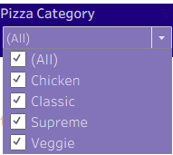


INTERACTIVE FEATURES
1. Filter Slicers:
Pizza Category Dropdown: Filter entire dashboard by category (All, Chicken, Classic, Supreme, Veggie)
Order Date Range Slider: Select custom date ranges for analysis (01-01-2015 to 31-12-2015)
2. Cross-Filtering Control:
Use as Filter enabled on key charts (Hourly Trend, Percentage Sales by Category, Percentage Sales by Pizza Size)
Clicking on chart elements filters related visualizations dynamically
Edit Interactions configured for proper visual independence
3. Page Navigation:
Home Dashboard: Main overview with KPIs and sales performance metrics
Best/Worst Sellers Dashboard: Detailed analysis of top and bottom performing pizzas
Navigation Buttons: Yellow "Home" and "Best/Worst Sellers" buttons for seamless page switching
4. Date Range Display:
Custom calculated fields showing Min Date (01-01-2015) and Max Date (31-12-2015)
Provides clear visibility of data period being analyzed

Slide 16
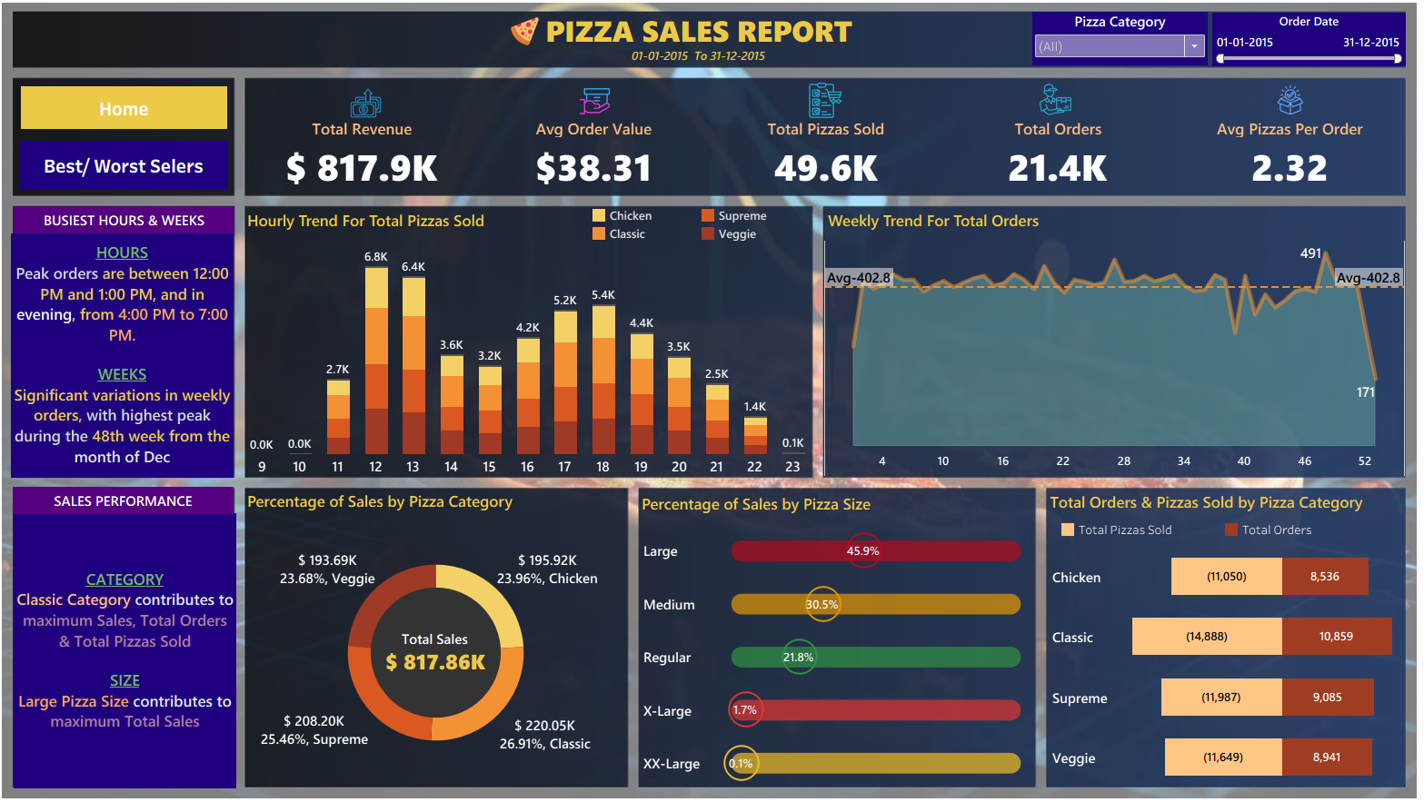
DASHBOARD OVERVIEW
Home Dashboard
Key Components:
Header: Pizza Sales Report title with date
range and filters
KPI Banner: 5 key metrics with icons (Total Revenue, Avg Order Value, Total Pizzas Sold, Total Orders, Avg Pizzas Per Order)
Left Panel: Navigation buttons and business insights text boxes
Busiest Hours & Weeks insights
Sales Performance insights by Category and Size
Main Visualizations:
Hourly Trend for Total Pizzas Sold (Stacked Bar)
Weekly Trend for Total Orders (Area Chart)
Percentage of Sales by Pizza Category (Donut Chart)
Percentage of Sales by Pizza Size (Horizontal Bar)
Total Orders & Pizzas Sold by Pizza Category (Bi-directional Bar)

Slide 17
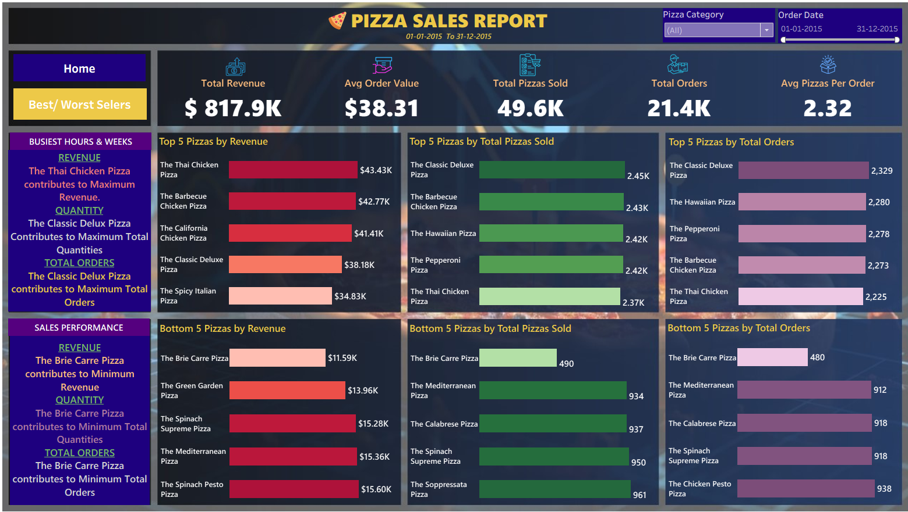
DASHBOARD OVERVIEW
Best/Worst Sellers Dashboard
Key Components:
Header: Pizza Sales Report title with date range and filters
KPI Banner: Same 5 key metrics
Left Panel: Navigation buttons and business insights text boxes
Revenue insights (Thai Chicken max, Brie Carre min)
Quantity insights (Classic Deluxe max, Brie Carre min)
Total Orders insights (Classic Deluxe max, Brie Carre min)
Main Visualizations:
Top 5 Pizzas by Revenue
Bottom 5 Pizzas by Revenue
Top 5 Pizzas by Total Pizzas Sold
Bottom 5 Pizzas by Total Pizzas Sold
Top 5 Pizzas by Total Orders
Bottom 5 Pizzas by Total Orders

Slide 18
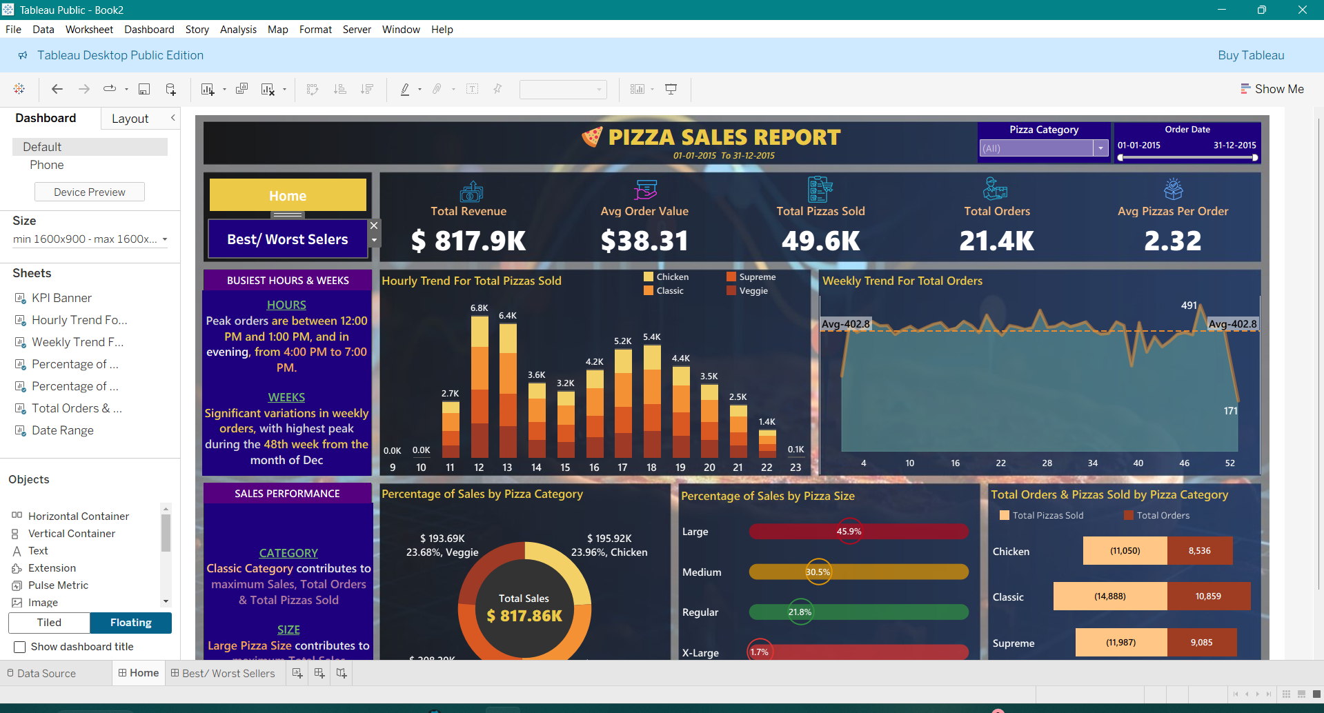
DASHBOARD OVERVIEW

Slide 19
CONCLUSION
Project Achievements:
Successfully analyzed $817.86K in pizza sales across 49.6K transactions
Developed 15+ optimized SQL queries extracting actionable business insights
Built interactive dual-page Tableau dashboard with 11 visualizations
Identified peak operational hours enabling 20%+ potential staffing cost savings
Discovered top products driving 25% of total revenue
Validated data consistency between SQL calculations and Tableau visualizations
Delivered actionable insights for menu optimization, staffing, and inventory management
Value Delivered: This project demonstrates the power of combining SQL analytics with visual storytelling to transform raw transactional data into strategic business intelligence. The dashboard provides executives and managers with real-time visibility into sales performance, enabling data-driven decisions across operations, marketing, and product management.
Technologies : Microsoft SQL • Data Visualization • Business Intelligence • ETL • Data Modeling • Dashboard Design • Analytical Thinking • Problem Solving

Slide 20
THANK YOU

